Slide 1
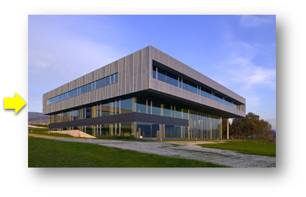
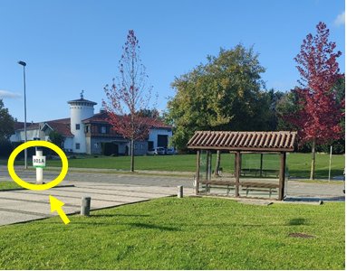
Useful information
Meeting venue:
CIC bioGUNE - Centro de Investigación Cooperativa en Biociencias
Parque Científico Tecnológico de Bizkaia building 800 48160 Derio Biscay
Spain
Transportation:
From the airport to CIC bioGUNE: Taxi – distance 5km, duration 10min, costs ~15 – 20 EUR. Taxis are readily available outside the arrivals area of the Bilbao airport.
From the airport to the city centre:
BUS - line A3247 (30min), direct bus to Termibus (main bus station) or can be taken to stops Gran Vía 79, Plaza Moyua Osaguna/Hacienda and Alameda Recalde 11.
TAXI – duration ~ 15min, costs 25 – 30 EUR approx.
From the city centre to CIC bioGUNE:
BUS (~1.5 EUR per journey, tickets can be bought from driver): line A3250 (30min) from Moyua Plaza (Nekazaritza Eskola/escuela Agraria stop 3912). Get off at stop Abeletxea/granja (926) in front of the institute and take the stairs down to building 800.
TAXI – distance ~10km, duration ~20min, costs ~30 EUR.

